Slide 1




Northern VA CodeCamp Fall 2017
is sponsored by

Slide 2
R for Non-Data Nerds
(Like Me)
Dan Stalcup
daniel.stalcup@excella.com
@StalcupDan

Slide 3
Resources for this Presentation
http://danstalcup.com/r/

Slide 4
The next hour (by the numbers)
5 key takeaways
12 nifty R tricks
4 pictures of my daughter
3 fun data sets
1 Taylor Swift reference
5 essential third party packages
0 jokes about how R is a pirate’s favorite stats language
(except that one ^^)

Slide 5
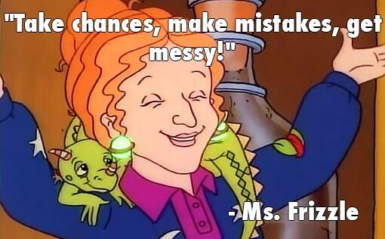
Origin of This Talk. Perspective. Disclaimer.
I like learning new things.
I am a junior developer who is not yet an expert. But trying.
This talk is about my (ongoing!) journey.

Slide 6
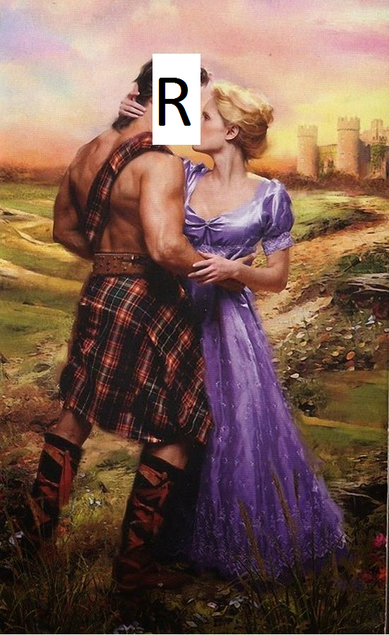
Why this talk matters now
Data is hot!
All developers should care about data
Harvard Business Review calls data scientist:
The sexiest job of the 21st century

Slide 7
Five Takeaways
Data tells stories. Stories matter.
R is for the modern developer.
What you would do in Excel, do in R.
Get fancy with packages.
Start telling stories in minutes.

Slide 8

Let’s Get Started! How I Got Here
“According to the map, we’ve only gone four inches”
Dumb and Dumber

Slide 9




My Background

Slide 10

My Bio
Dan Stalcup is a Consultant and .Net Developer at Excella Consulting.
He loves stories, board games, Tchaikovsky, procedural generation, and his three month-old daughter, Eleanor. He’s an INFP and an optimist – come say hi!

Slide 11
The Power of Stories
“When you want to motivate, persuade, or be remembered, start with a story of human struggle and eventual triumph. It will capture people’s hearts – by first attracting their brains.” – Harvard Business Review

Slide 12



Stories!

Slide 13



Favorite Stories

Slide 14
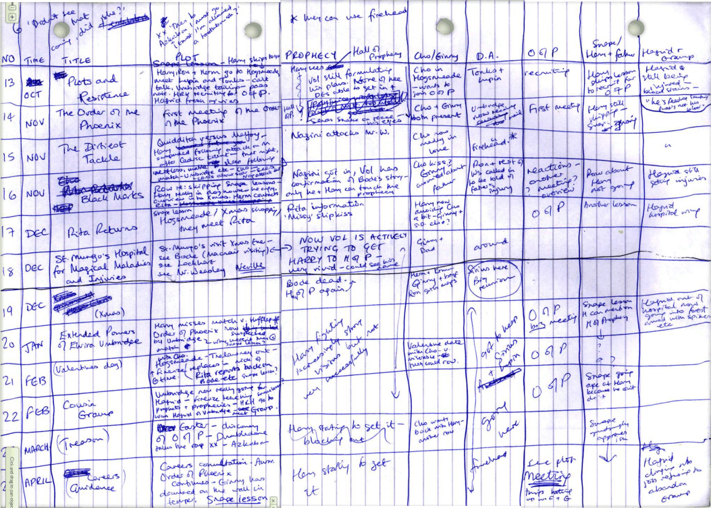
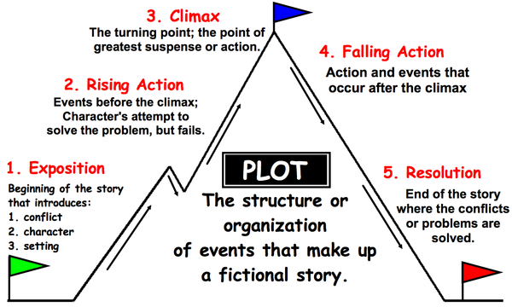
Structure to the Story

Slide 15
API Layer = Telling Stories?
Entities/characters change between start and end
Careful structure
Cause and effect
Point A to Point B
Diction and syntax matter
Organization and clarity of thought are paramount

Slide 16
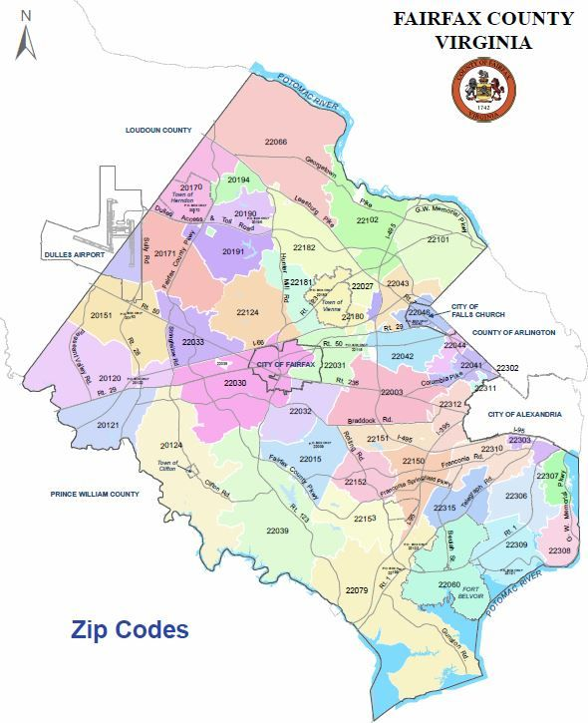
The Challenge

Slide 17
THE DATA……

Slide 18
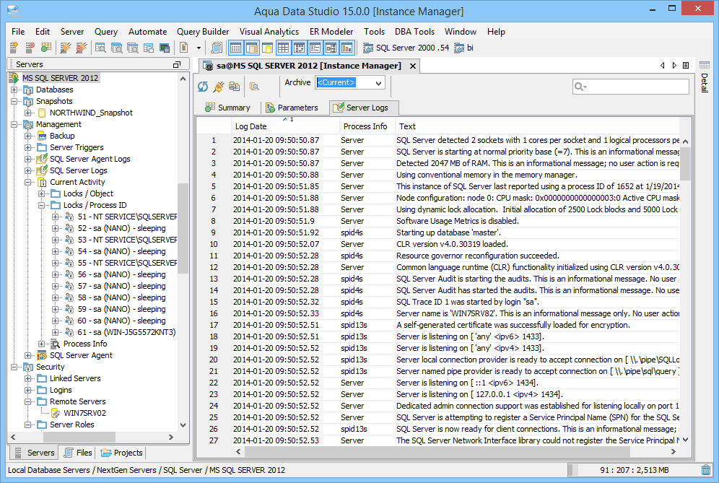

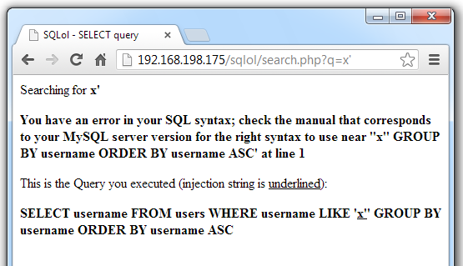
What?

Slide 19
The Solution
I know some SQL! I majored in math!
A = Revenue, Grouped by Zip Code
B = Number of Addresses by Zip Code (Mailing List)
A / B = C = Revenue Per Address
Order by C. Big is good.

Slide 20
Hmm
“Why is that Zip Code ranked higher than that one?”
“Huh. I dunno. Let me check THE DATA.”
…Ten minutes later…
“Oh, there are a lot of payments with the same User ID’s from that Zip Code. A few families are generating a lot of revenue.”
“Why that zip code?”
“Huh. I dunno. Let me check THE DATA and cross-reference school boundaries to see if that’s a factor.”
…Ten minutes later…

Slide 21

Hang On a Sec…
THIS IS KINDA FUN

Slide 22

Why?
Am I a masochist who loves writing SQL queries?
No
Am I a postal code zoning enthusiast?
No
Do I like solving challenging, interesting problems?
Yeah! Let’s follow that.

Slide 23
Data Layer = Telling Stories?
Developer crafts archetypes; user becomes “character”
Extracting themes from characters’ “adventures”
Characters have a distinct “voice”
Represents a fleshed out, unique world
Unpredictable. Lots of twists.
Look closely. Think about it. Find the moral.

Slide 24
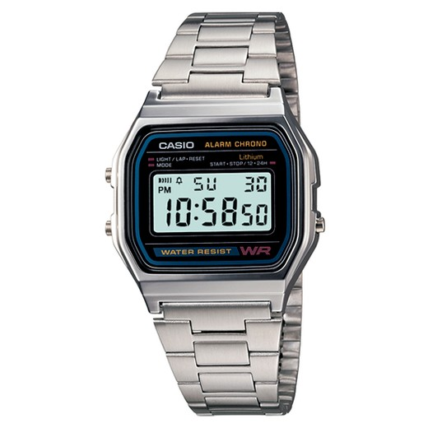
Another Example
Product Owner Proposed Missed Requirement
High-risk pension calculation rule
Would Require…
New domain logic
Thorough automated testing
Business Analysis of Test Cases
Regression Testing
Dependency For Other Stories
By the End of the Sprint, Ending in Two Days

Slide 25
Tell Me a Story, O Data!!
1
Last year’s production data
Reviewed all possible cases with various data investigations
Number of users, among 20,000+, to need this rule?
Cataloged the lone test case
Used it to tell a “story” of this uncommon scenario
Stakeholders moved requirement much lower in backlog
Data “storytelling” surfaced knowledge about users and product

Slide 26
Five Takeaways
Data tells stories. Stories matter.
R is for the modern developer.
What you would do in Excel, do in R.
Get fancy with packages.
Start telling stories in minutes.

Slide 27
How should deal with data?
Let’s check the name of the conference today:
Northern VA MicrosoftExcelCamp Fall 2017?
Northern VA AskASysAdminForHelpCamp Fall 2017?
Northern VA AwkwardlyEditCSVFilesThenPlugSomeNum-ersIntoTheWindowsCalculator Fall 2017?
Northern VA CODECamp Fall 2017?

Slide 28
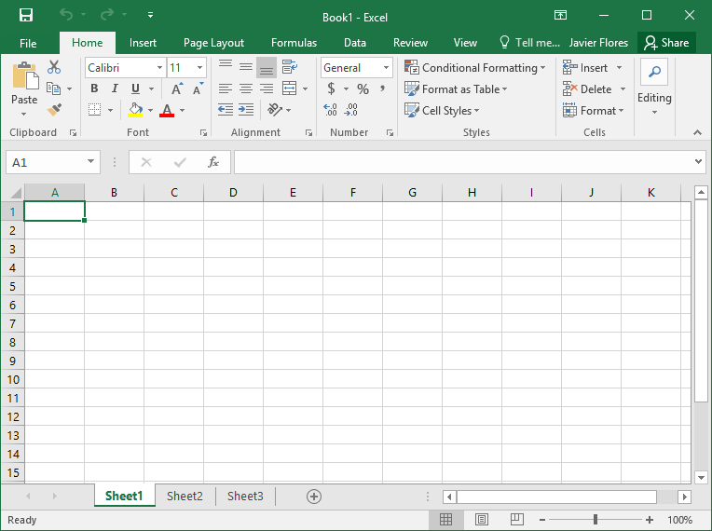
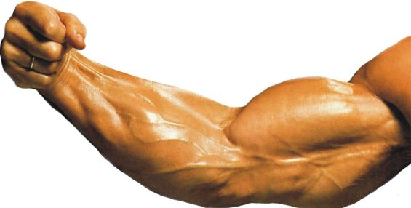

What Is a “Stats/Data Dev Language?”
Think of it as…
Excel, but coded and vastly more powerful
After assembling data sets, you can:
Run calculations
Graph
Use formulas to easily manipulate data

Slide 29

Picking a Stats Language
A few options:
Scala
Matlab
Python + Frameworks
Java + Frameworks

Slide 30
R

Slide 31
Why R?
From The Art of R Programming by Norman Matloff
“As the Cantonese say, yauh peng, yauh leng, which means ‘both inexpensive and beautiful.’ Why use anything else?”

Slide 32
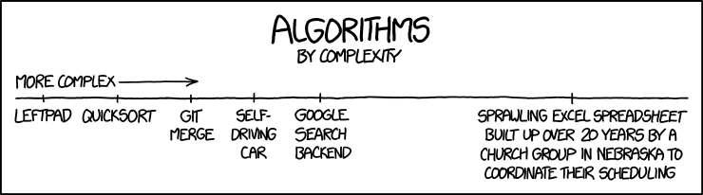
Why do developers prefer R?
Part 1: Design
GNU – Open source, free forever on any scale
Cross platform
Highly extensible – Robust libraries
Emphasis on integration and interopability
Big deal for full stack developers
Lightweight – interpreted, not compiled
Composability – functional design allows nesting functions
Scripted – operations are highly repeatable

Slide 33

Why do developers prefer R?
Part 2: Architecture
Clean, optimized architecture – handles large data sets well
“Big Data”
Designed to naturally be asynchronous / parallelized

Slide 34


History of R
1975 – S created by AT&T
1992 – Two New Zealand professors wanted a programming language for a stats class
1995 – They adapt S into R and give it to students for lessons and labs
1997 – Windows, Mac OS versions created
1997 – Joins GNU Project
2000 – Gains underground popularity

Slide 35

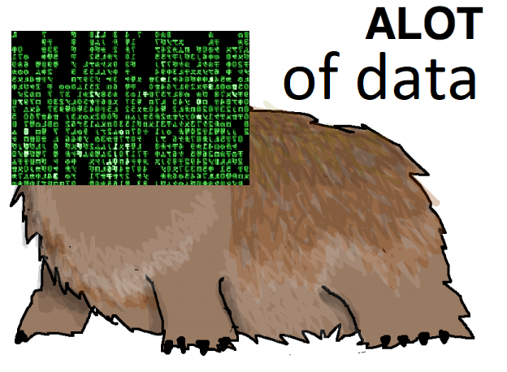
History of R
2001 – Max OSX version created
2005 – International encoding support
2010 – 64 bit version
2011 – Improved interpretation, even faster
Java style byte-code for libraries
2013 – Vector size max upped to 2 billion+
2016 – SQL server integration

Slide 36
Five Takeaways
Data tells stories. Stories matter.
R is for the modern developer.
What you would do in Excel, do in R.
Get fancy with packages.
Start telling stories in minutes.

Slide 37
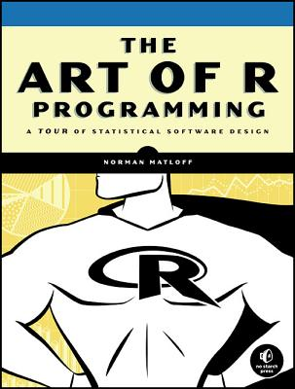

Let’s Dive In!!
Chapters 1-3
(of 16)

Slide 38
Resources, Code, Data, and Links
http://danstalcup.com/r/

Slide 39
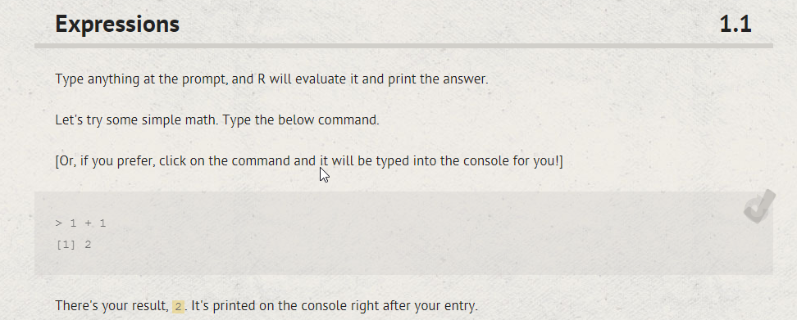
The No-Barriers Entry Point
http://tryr.codeschool.com/

Slide 40
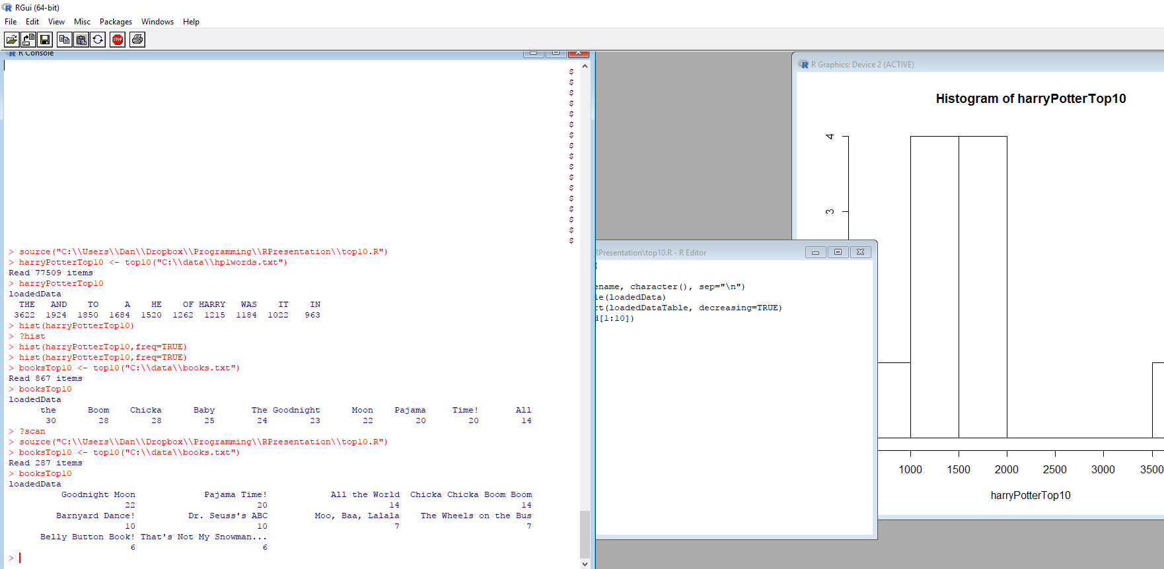
The Full-Experience Entry Point
https://www.rstudio.com/

Slide 41

LET’S GET DOWN TO BUSINESS
12 Nifty Tricks

Slide 42
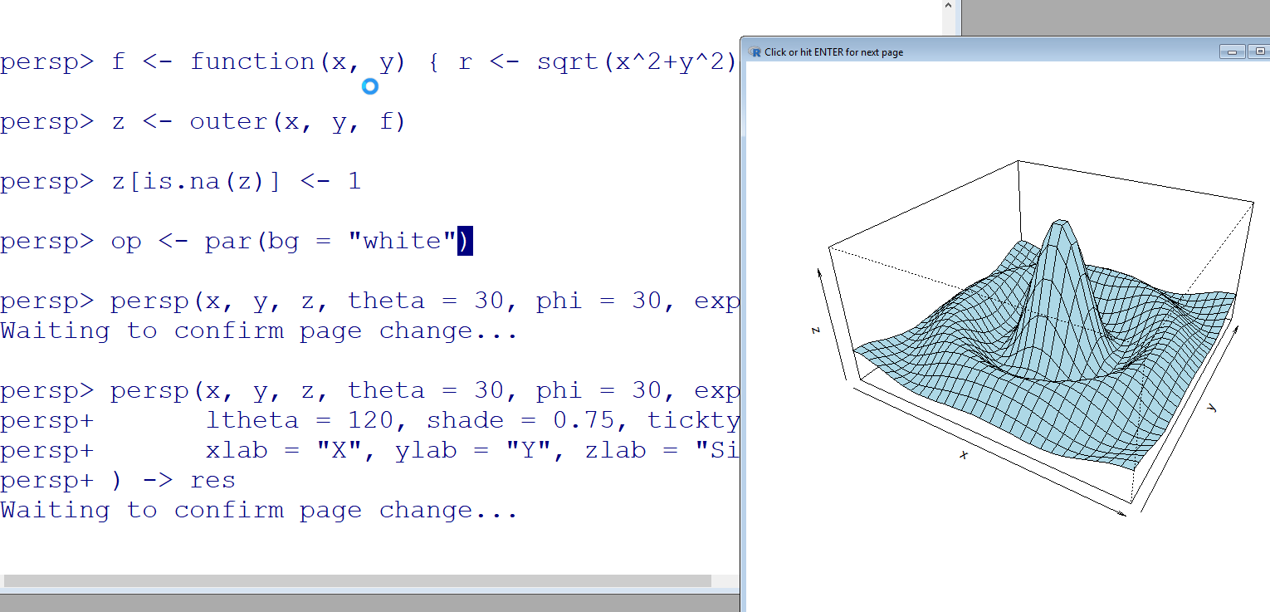
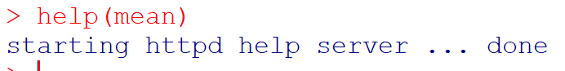
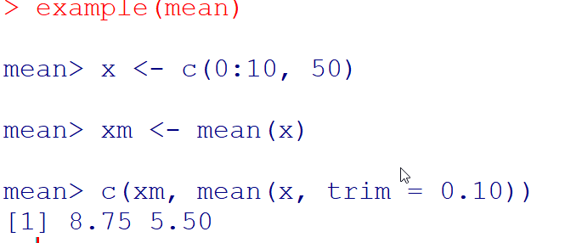
Nifty Thing 1: Teach You Itself

Slide 43

Data Set: Russell Westbrook

Slide 44
Points Scored Every Game, 2016-17
32, 51, 33, 35, 20, 28, 14, 36, 29, 41, 33, 30, 30, 31, 34, 31, 36, 17, 27, 35, 28, 32, 27, 37, 20, 27, 26, 46, 42, 45, 31, 29, 21, 17, 30, 33, 49, 32, 21, 24, 21, 36, 24, 27, 38, 27, 45, 20, 27, 28, 38, 42, 27, 29, 47, 17, 38, 17, 41, 43, 45, 48, 29, 58, 23, 33, 25, 24, 28, 15, 18, 39, 37, 57, 32, 40, 12, 45, 23, 50

Slide 45
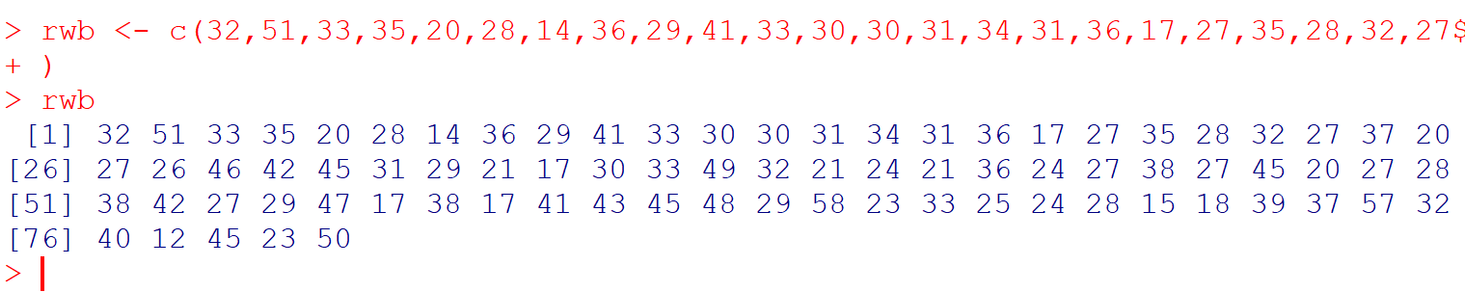
Nifty Thing 2: Create a Vector

Slide 46
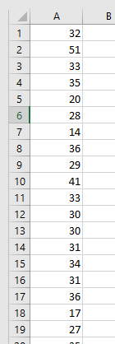


What’s a Vector?
BASE VARIABLE IN R IS A VECTOR

Slide 47

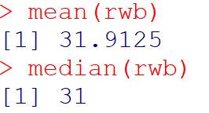
Nifty Thing 3: Mean and Median
Notice! Still a vector!
(Size 1)

Slide 48

Hang on…
Russell Westbrook averaged 31.6, NOT 31.9

Slide 49
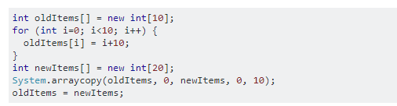

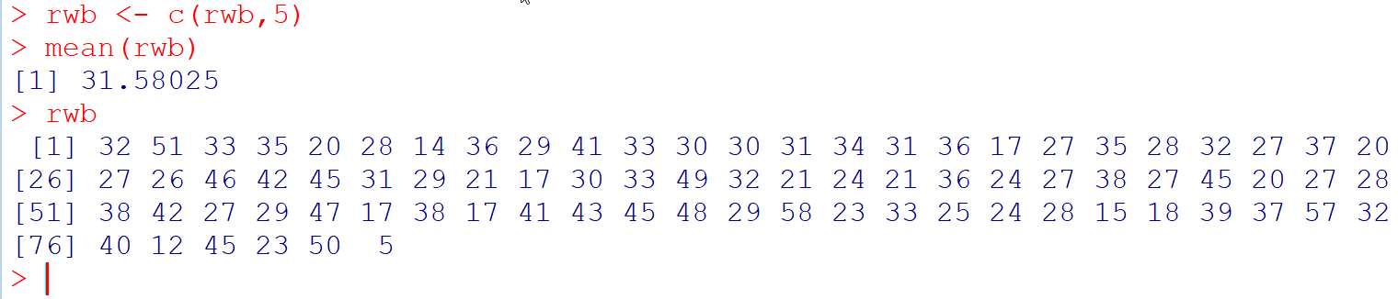
Nifty Thing 4: Easily Append Vectors

Slide 50

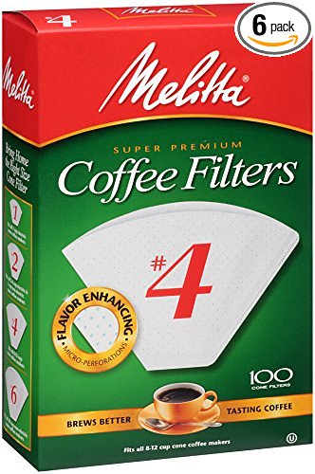
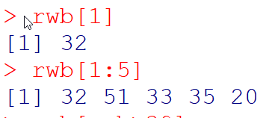
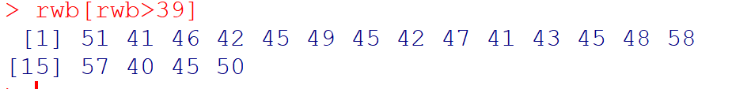
Nifty Thing 5: Smart Filtering

Slide 51

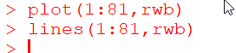
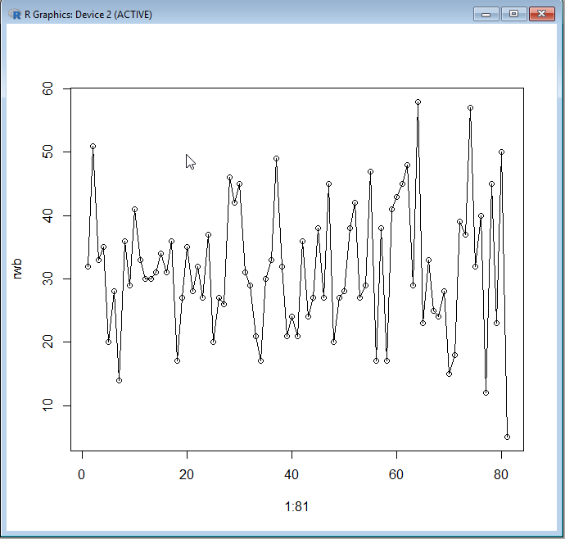
Nifty Thing 6: Simple Graph Plots

Slide 52

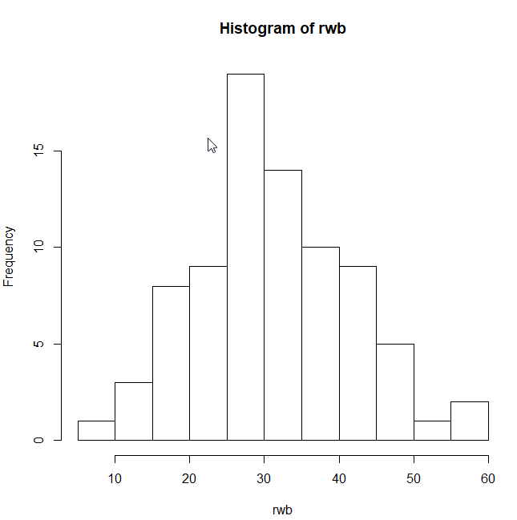
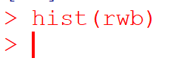
Nifty Thing 7: Histograms

Slide 53

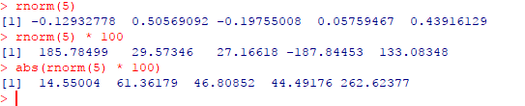
Nifty Thing 8: Random Numbers

Slide 54

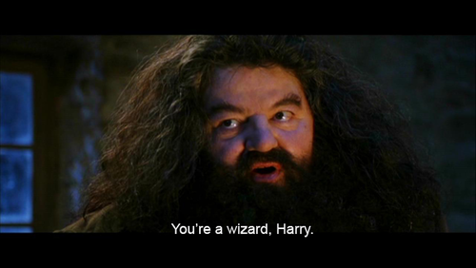
Nifty Thing 9: Import Data

Slide 55
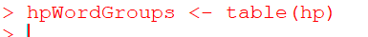
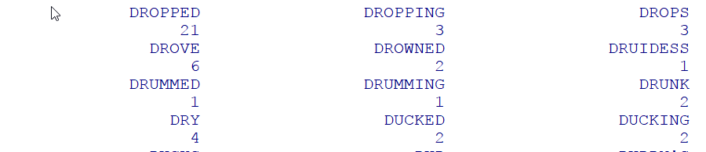
Nifty Thing 10: Group Data By Type

Slide 56
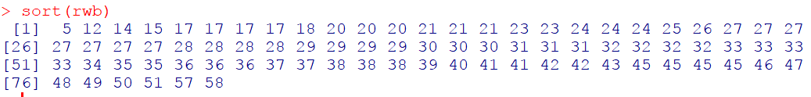
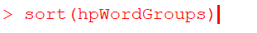
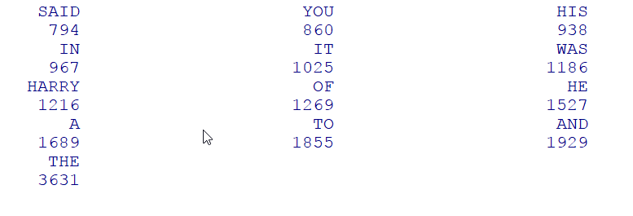
Nifty Thing 11: Sort Data
THE

Slide 57

Nifty Thing 12: Custom Functions
Let’s write a function to:
1) Read in a text file
2) Group the data by type
3) Sort the data by frequency
4) Pick the top 10 most frequent data points

Slide 58

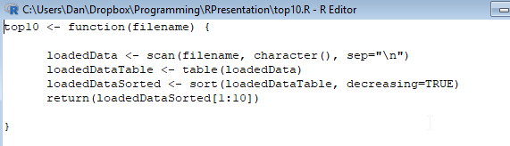
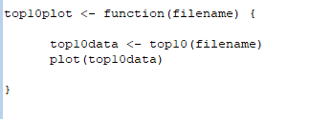
Creating the Function in a Script

Slide 59



Data Set 3: Reading To Eleanor

Slide 60

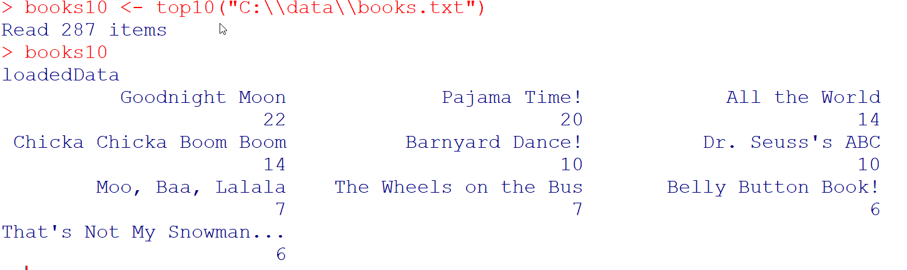
Using Your Custom Script

Slide 61
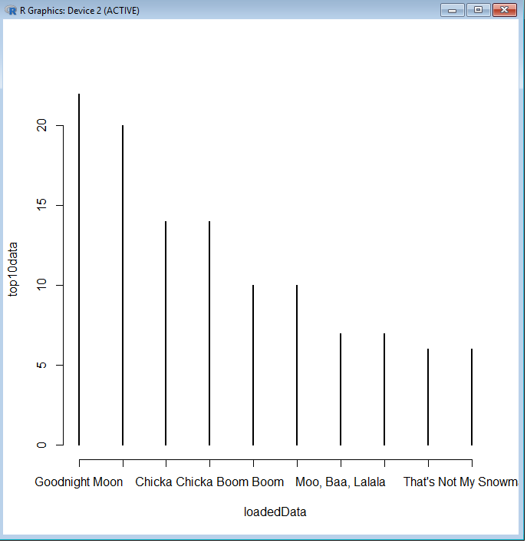
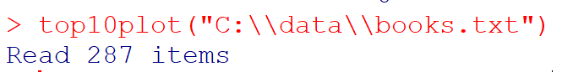
Using Your Custom Script, Part 2

Slide 62
Five Takeaways
Data tells stories. Stories matter.
R is for the modern developer.
What you would do in Excel, do in R.
Get fancy with packages.
Start telling stories in minutes.

Slide 63
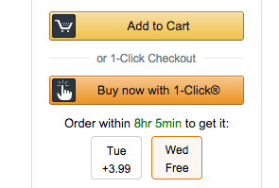
Easy Importation Of Packages
Packages In Three Easy Steps!
setRepositories()
install.packages(“packagename”)
Go!

Slide 64
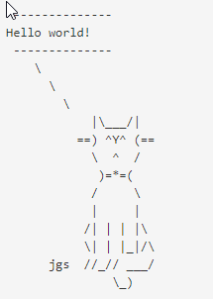
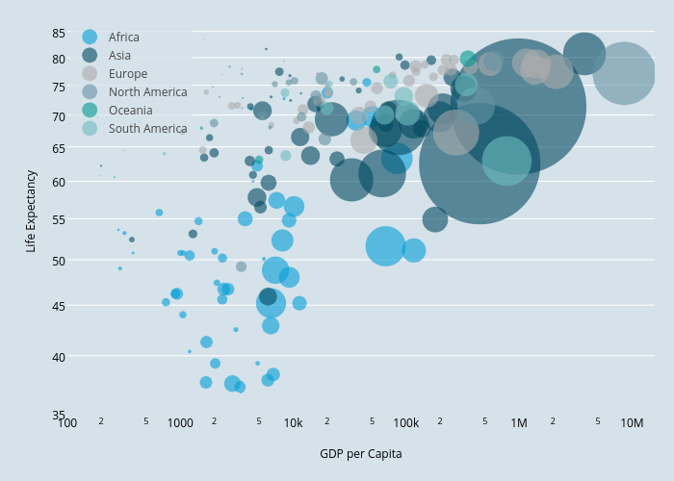
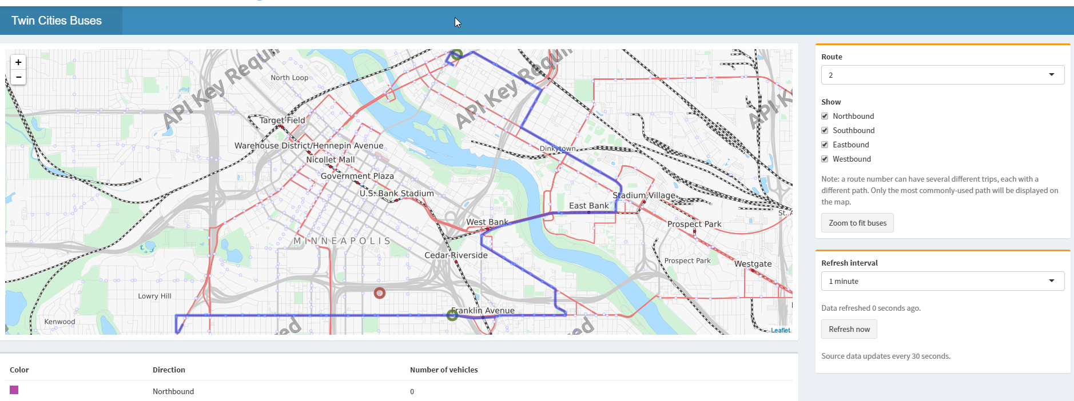
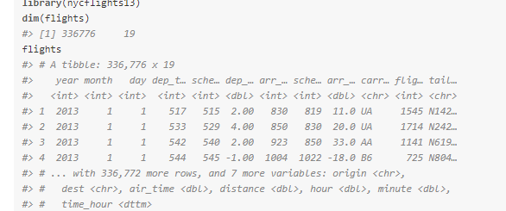
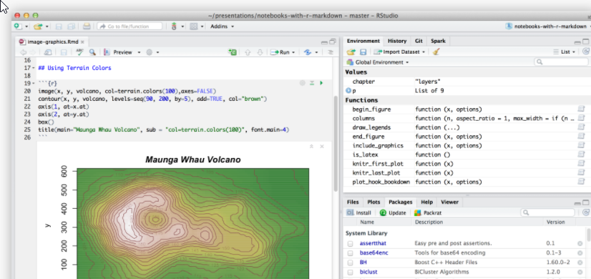
A few essential third party packages
ggplot2 → much prettier graphs
shiny → build web apps and interactive viz out of R
dplyr → streamlined data manipulation
rmarkdown → create documents and deliverables
cowsay → talking animal text art

Slide 65
Five Takeaways
Data tells stories. Stories matter.
R is for the modern developer.
What you would do in Excel, do in R.
Get fancy with packages.
Start telling stories in minutes.

Slide 66
Call to Action
Find a story data can help you tell.
Or wait for one to find you.
Use R. Even just a little.

Slide 67

It’s Not Difficult to Get Started
http://danstalcup.com/r/
Do the Try R tutorial
Download RStudio and do some nifty tricks
Take chances, make mistakes, get messy

Slide 68
Five Takeaways
Data tells stories. Stories matter.
R is for the modern developer.
What you would do in Excel, do in R.
Get fancy with packages.
Start telling stories in minutes.

Slide 69
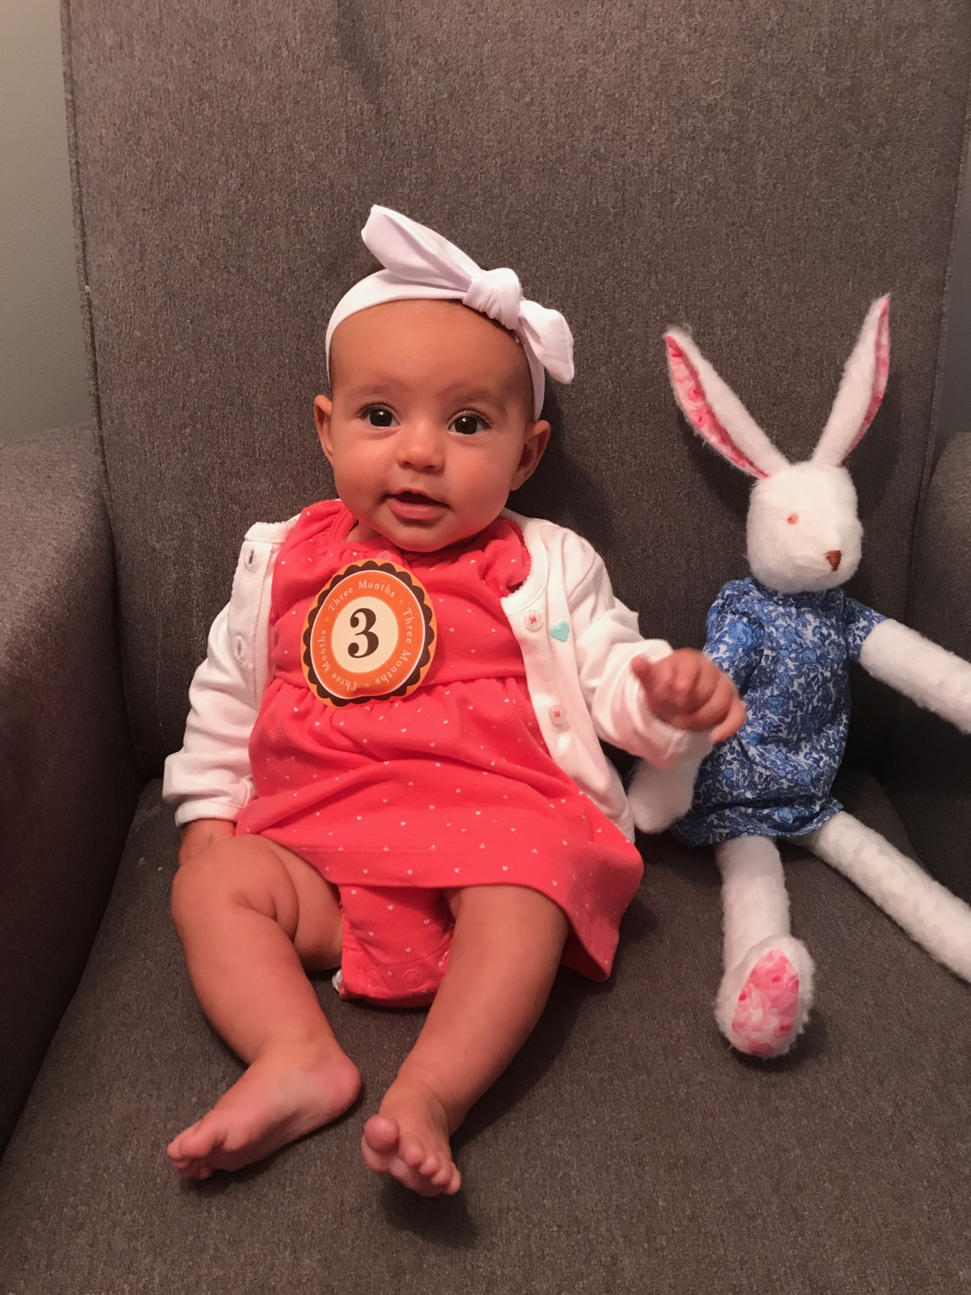
I promised a fourth picture!!

Slide 70


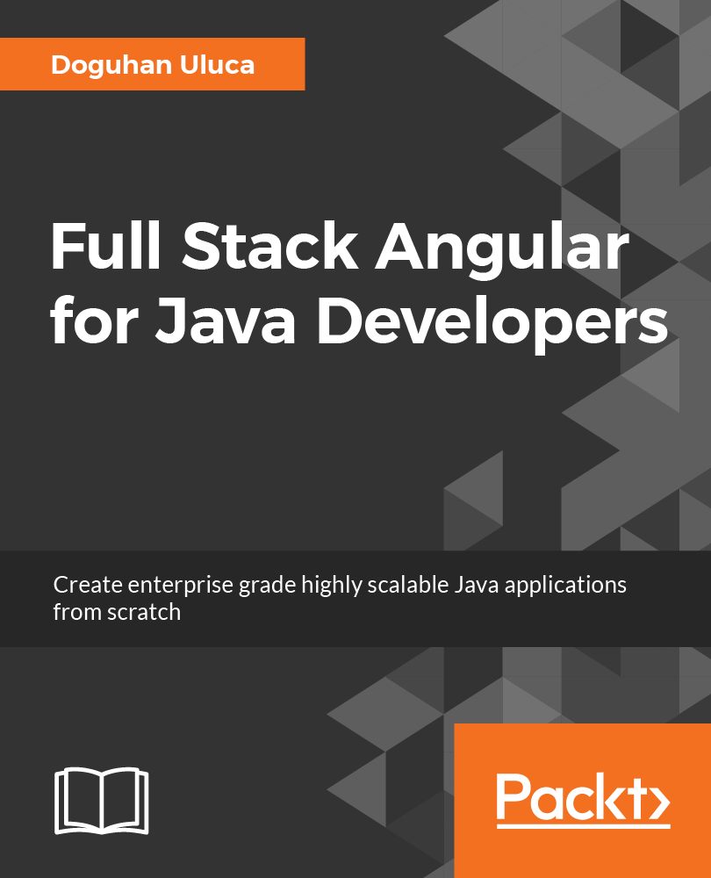

Sign up for the book raffle at the Excella Booth
Order Now
Pre-Order & Save 50%
http://bit.ly/FunctionalDotNet
http://bit.ly/FullStackAngular

Slide 71
Northern VA CodeCamp Fall 2017
is sponsored by

